Slide 1
Python Basics Functions
Dr. Tim McGuire Grateful acknowledgement to David Kebo Houngninou for some of the material contained in these slides

Slide 2
Topics (1 of 2)
Introduction to Functions
Defining and Calling a Void Function
Designing a Program to Use Functions
Local Variables
Passing Arguments to Functions
Global Variables and Global Constants

Slide 3
Topics (2 of 2)
Introduction to Value-Returning Functions: Generating Random Numbers
Writing Your Own Value-Returning Functions
The math Module
Storing Functions in Modules

Slide 4
What is a function?
A function is a named sequence of statements that performs a computation.
When we define a function, we write the name and the sequence of statements.
To use the function, we call the function by name.

Slide 5
Introduction to Functions (1 of 2)
Function: group of statements within a program that perform as specific task
Usually one task of a large program
Functions can be executed in order to perform overall program task
Known as divide and conquer approach
Modularized program: program wherein each task within the program is in its own function

Slide 6
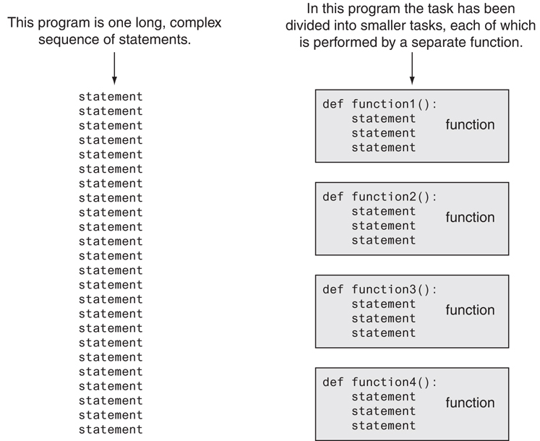
Introduction to Functions (2 of 2)
Using functions to divide and conquer a large task

Slide 7
Functions: properties
Functions can be defined as a block of re-usable code to perform specific tasks.
Reusable code blocks only need to be written once, then they can be used multiple times.
Functions can be part of the language (built-in functions) or can defined by the users (user-defined functions).
Functions are called inside the codes with:
input parameters (arguments)
return values
Notes:
A parameter is a variable in the declaration of function.
An argument is the actual value of this variable that gets passed to function.

Slide 8
Functions: example
We have already used some function calls:
e.g.: type(3.14)
The name of the function is:
type
The expression in parentheses is the argument of the function: (3.14)
The result, for this function, is the type of the argument:
<class 'float'>

Slide 9
Why do we use functions?
Modularity: functions break a program into smaller and modular blocks.
Organization: functions can help manage and organize larger programs
Simplification: functions avoid repetition and makes code reusable.
Reusability: Once a function is defined, it can be reused several times. We can invoke the same function many times at different location in a program.
Abstraction: Functions provide a high-level view of the program components whose detailed can be filled in later.
Better testing and debugging :Can test and debug each function individually
Easier facilitation of teamwork: Different team members can write different functions

Slide 10
Void Functions and Value-Returning Functions
A void function:
Simply executes the statements it contains and then terminates.
A value-returning function:
Executes the statements it contains, and then it returns a value back to the statement that called it.
The input, int, and float functions are examples of value-returning functions.

Slide 11
Defining a Function
Functions are given names
Function naming rules:
Cannot use keywords as a function name
Cannot contain spaces
First character must be a letter or underscore
All other characters must be a letter, number or underscore
Uppercase and lowercase characters are distinct
Function name should be descriptive of the task carried out by the function
Often includes a verb or verb phrase

Slide 12
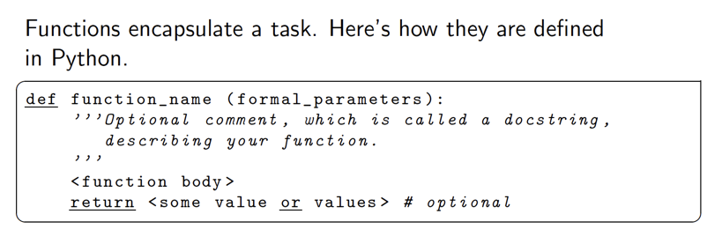
Functions: definition

Slide 13
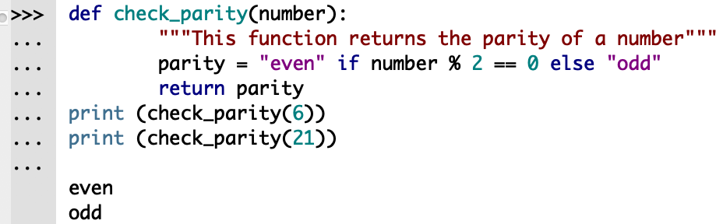
Functions: docstring
The docstring (documentation string) is a string placed after the header. It describes the function.
It is a good programming practice to include a docstring in a function for documentation

Slide 14
Calling a Function
Call a function to execute it
When a function is called:
Interpreter jumps to the function and executes statements in the block
Interpreter jumps back to part of program that called the function
Known as function return

Slide 15
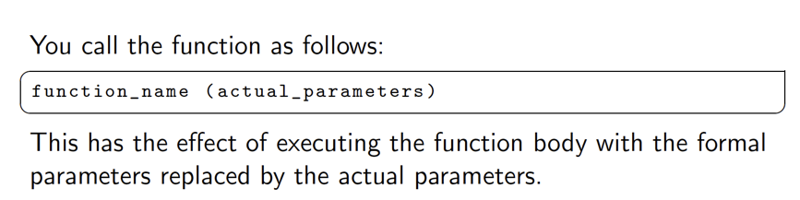
Functions: call

Slide 16
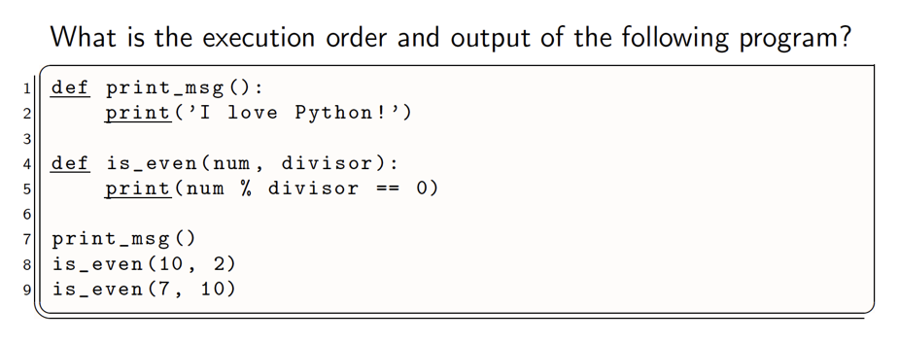
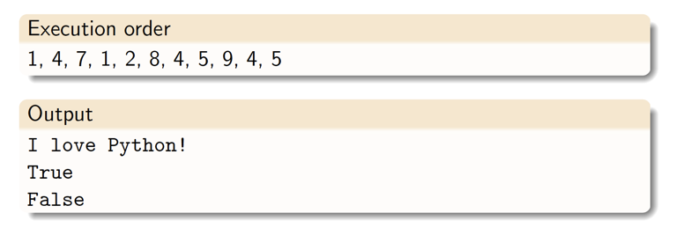
Functions: example

Slide 17
Functions: main()
The main() function is a special function that runs automatically when the program is executed.
It is not required to use main() in Python, but it is a good programming practice for the logical structure of the code.
We can rename the function main() if used as a regular function.
The name main() is consistent with some of the other programming languages.

Slide 18
Functions: main()
In C, C++, C#, Java et,. all these programming languages require the main function to execute the program and without it, we cannot execute a program.
But it is not mandatory or necessary in the python language, we can execute a python program with or without the use of the main function.

Slide 19
Local Variables
Local variable: variable that is assigned a value inside a function
Belongs to the function in which it was created
Only statements inside that function can access it, error will occur if another function tries to access the variable
Scope: the part of a program in which a variable may be accessed
For local variable: function in which created
Local variable cannot be accessed by statements inside its function which precede its creation
Different functions may have local variables with the same name
Each function does not see the other function’s local variables, so no confusion

Slide 20
Passing Arguments to Functions (1 of 4)
Argument: piece of data that is sent into a function
Function can use argument in calculations
When calling the function, the argument is placed in parentheses following the function name

Slide 21
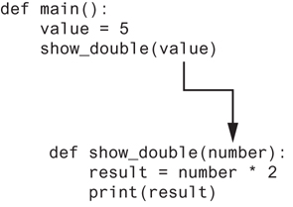
Passing Arguments to Functions (2 of 4)
The value variable is passed as an argument

Slide 22
Passing Arguments to Functions (3 of 4)
Parameter variable: variable that is assigned the value of an argument when the function is called
The parameter and the argument reference the same value
General format:
def function_name(parameter):
Scope of a parameter: the function in which the parameter is used

Slide 23
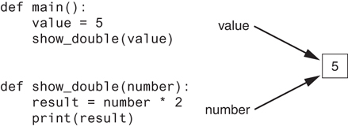
Passing Arguments to Functions (4 of 4)
The value variable and the number parameter reference the same value

Slide 24
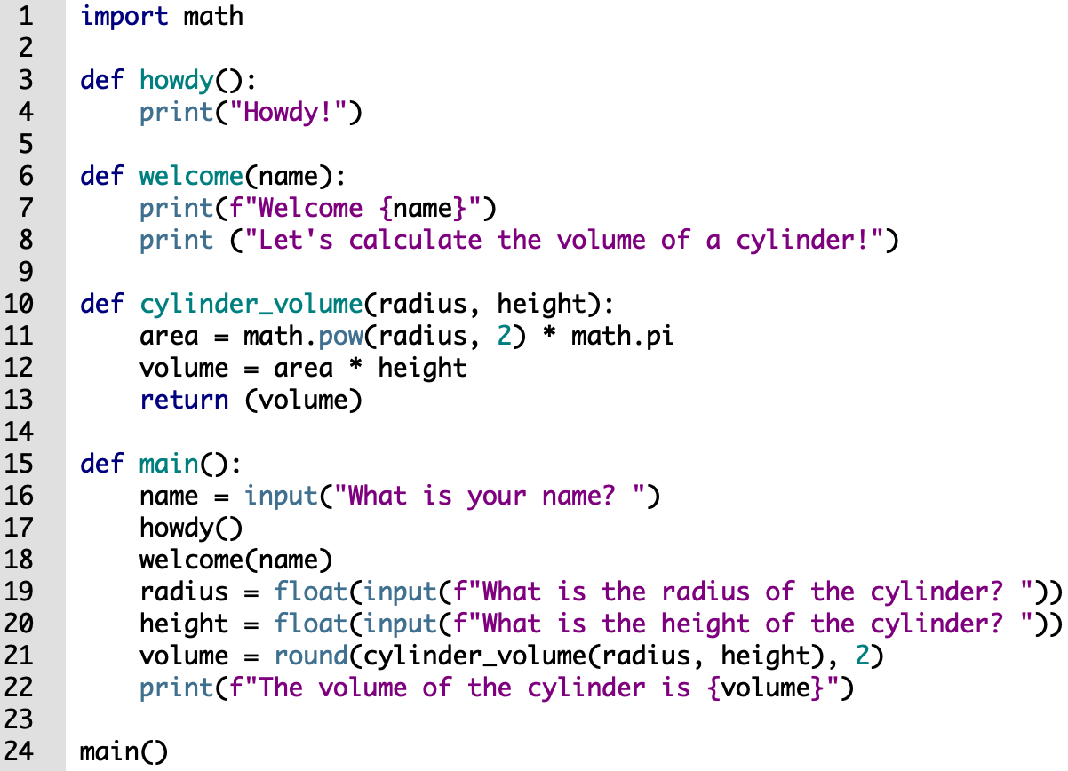
Example
Write the names of all the user-defined functions in this program
What are the arguments and return values of each function?
When do we need to use the return command?

Slide 25
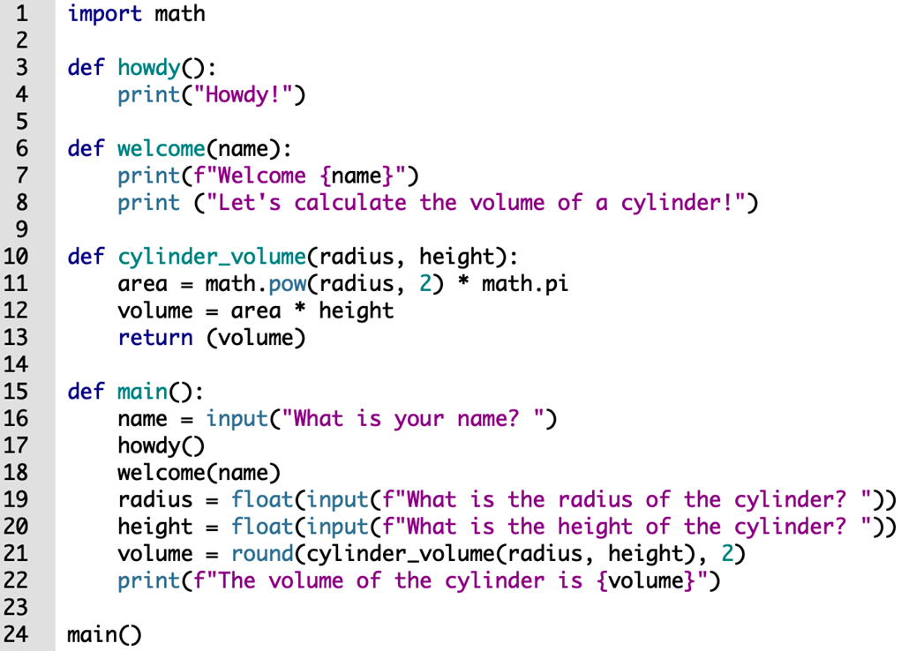
Example
Write the name of all the functions in this program
What are the arguments and return values of each function?
When do we need to use the return command?
Function name | arguments | return values
howdy() | none | none
welcome() | name | none
cylinder_volume() | radius, height | volume
main() | none | none
The return command causes execution to leave the current function.
It also allows the function to specify a return value to pass back to the code that called the function.

Slide 26
Methods vs. Functions
Method: a function that belongs to an object
Performs operations using that object
A method instructs an object to perform some action, and is executed by specifying the method name following a "." symbol and an object.
We’ve already seen several methods (for strings and lists), e.g.:
myString.find(“omp”)
myList.append(42)
myString.replace(‘one’, ‘uno’)

Slide 27
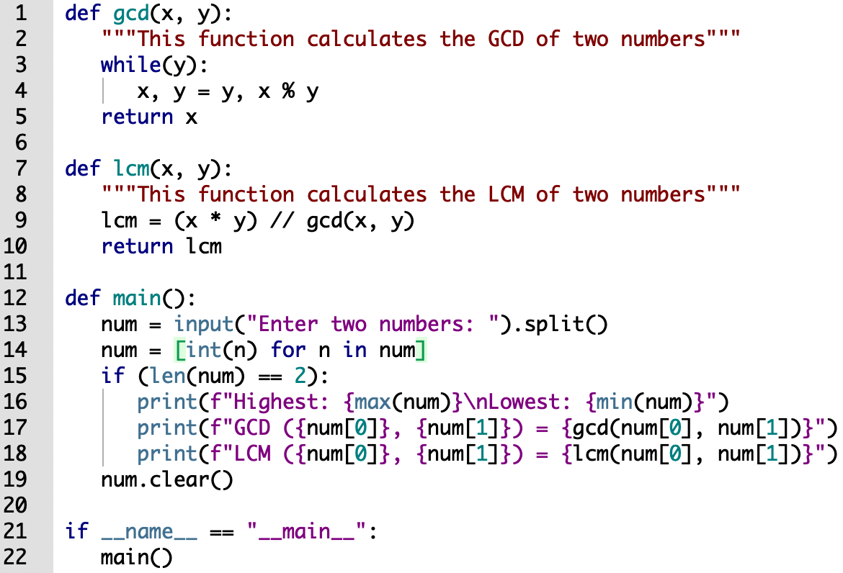
Types of functions
List built-in functions, methods and user-defined functions.

Slide 28
Types of functions
List built-in functions, methods and user-defined functions.
built-in functions | methods | user-defined functions
input() int() len() print() max() min() | split() clear() | gcd() lcm() main()

Slide 29
Example
Write a function that returns the absolute value of a number.
Use this function with a function call.

Slide 30
Functions: __name__ special variable
The interpreter sets a special variable __name__ to the value “__main__” when the program is executed by itself in a standalone way.
This helps us know whether the program is ran by itself or whether it is imported by another program.
Using this information, we may or may not execute some of the body of main().
Here is a scenario:
If we write multiple functions and a main function inside a program P₁
Then the functions in P₁ are imported by another program P₂
We would not want to execute the main function of P₁ in program P₂
Notes:
__name__ defines the namespace that a Python module is running in. When Python is run, it will replace __name__ with it's namespace.
If you're running a script, it will replace any instance of __name__ in that file with __main__ since it's running in the __main__ namespace. Any imported modules that Park.py uses, it will replace __name__ with the name of their own module. This is important because __name__ is often used in a module in the lines:

Slide 31
Example
Write two Python programs.
Each program includes a main function.
Import the functions from the first program into the second program and use them.

Slide 32
Functions: __name__ special variable
if __name__ == "__main__":
main()
The if statement checks the value of the __name__ variable.
If the value is "__main__", then the main function is called.
Otherwise, it is assumed that the program is imported into another program and we do not want to call main.
Note: conditional execution of the main function is useful when writing code that will be reused by other programs!

Slide 33
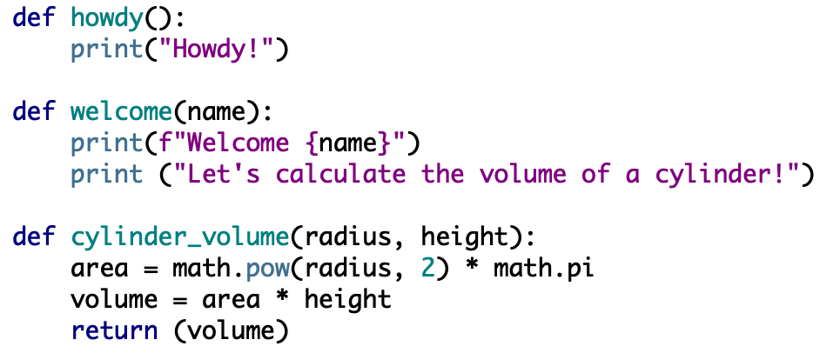
Functions
Classify the functions based on input parameters and return values.
Function | input | return values
howdy()
welcome()
cylinder_volume()

Slide 34
Functions
Classify the functions based on input parameters and return values.
Function | input | return values
howdy() | no | no
welcome() | yes | no
cylinder_volume() | yes | yes

Slide 35
Guessing game
Modify the The Guessing Game, by changing the part of the code to test if the number is too low or too high into a function.

Slide 36
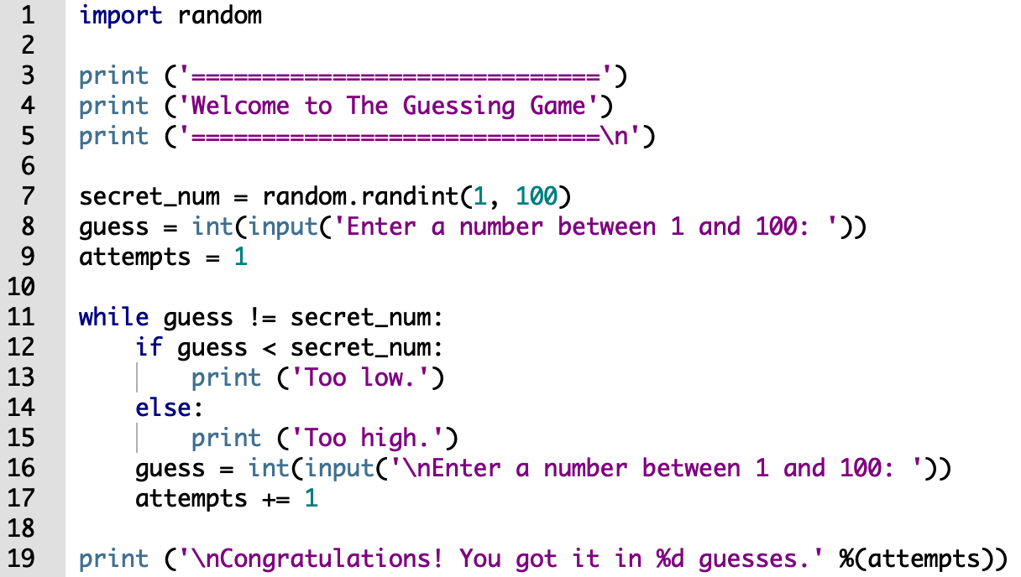
Guessing game

Slide 37
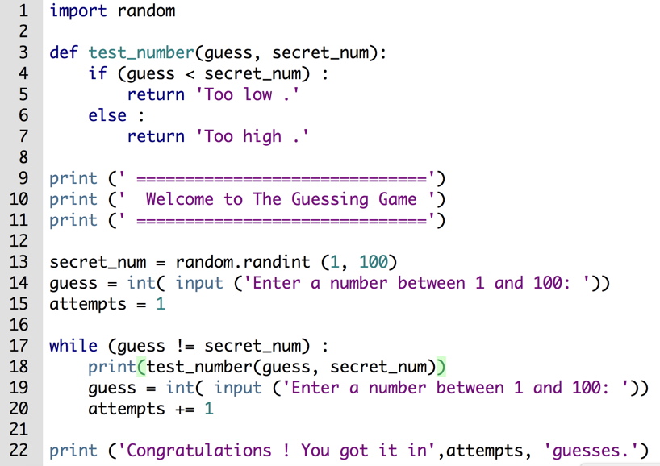
Guessing game

Slide 38
Variable scope
The scope of a variable is the visibility of the variable. It represents the regions of the program where the variable can be accessed and used.

Slide 39
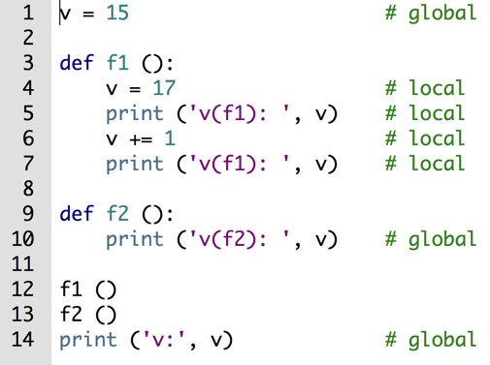
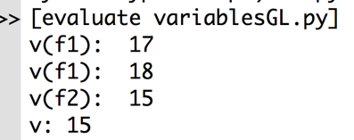
Functions: local variables vs global variables

Slide 40
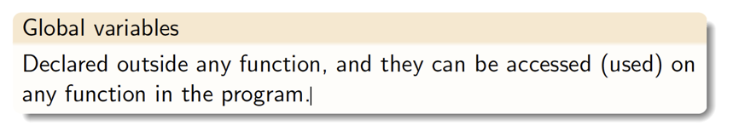
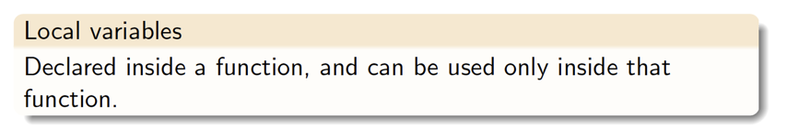
Variables scope: local vs global

Slide 41
Functions: local variables vs global variables
When we define a variable inside a function, it is local to the function.
Any changes to this variable has no effect on similar variables outside of the functions.

Slide 42
Functions: local variables vs global variables
A variable that is created inside a function is local if it is not declared as a global variable
To tell the interpreter that we want to use a global variable, we explicitly state it in the function using the global keyword
A variable cannot be local and global inside a function

Slide 43
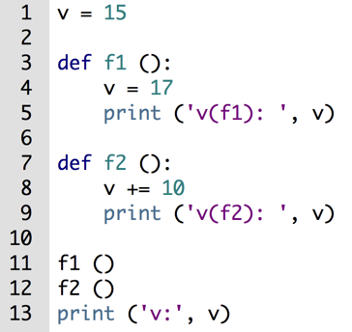
Example
This program contains an error.
Find it and explain why it is an error.

Slide 44
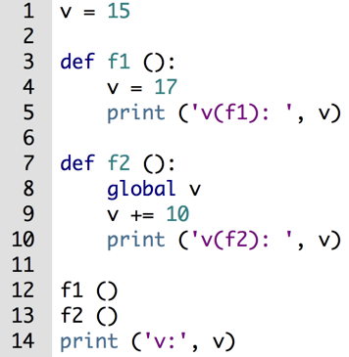
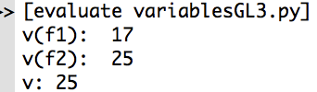
Example
To use the variable v in f2, declare v as global

Slide 45
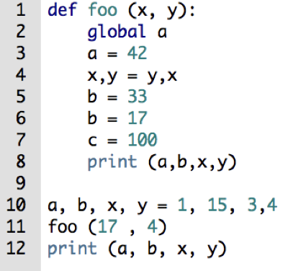
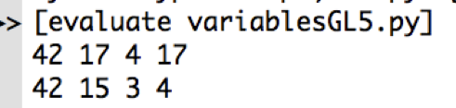
Functions: local variables vs global variables

Slide 46
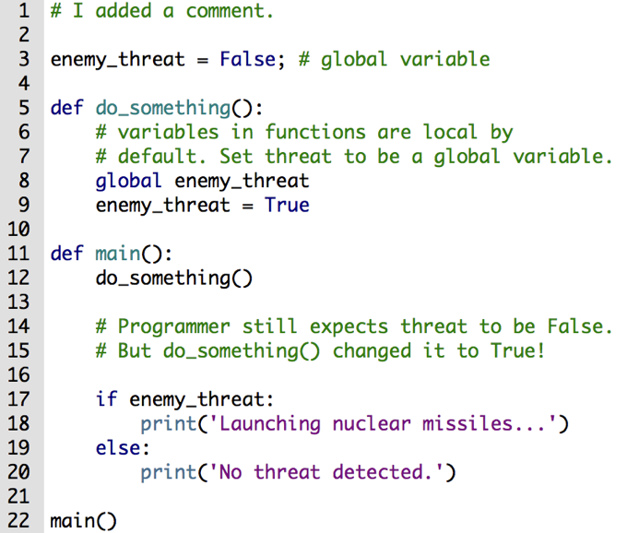
Functions: global variables
A function can modify a global Variable.

Slide 47
Functions: global variables
Use global variables with caution.
It is tempting to use lots of global variables because they are easy to work with - especially when many functions are involved.
Because every function has access to global variables, it can be hard to find which functions read and write these variables.
To understand how the program works, we have to check every function that modifies the global state.
Use local variables because other functions cannot affect them directly.

Slide 48
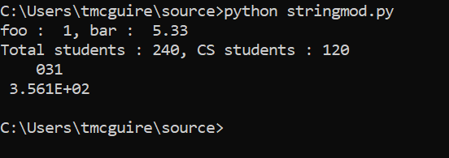
Another way of formatted print()
Formatting output using String modulo operator(%) :
The % operator can also be used for string formatting.
The first placeholder “%2d” is used for the first component of the tuple, i.e. the integer 1. The number will be printed with 2 characters, so the output is padded with 1 leading blank.
The second one “%5.2f” is a format description for a float number. The % character is followed by the total number of characters the string should contain, including the decimal point and all the digits before and after the decimal point.

Slide 49
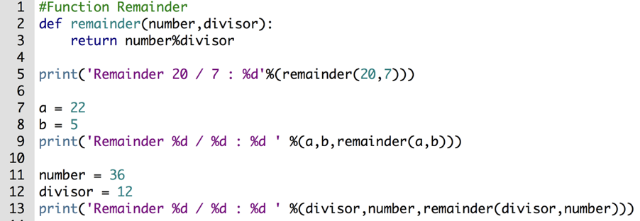
Functions: arguments position
When we call a function with values, the values are assigned to the arguments according to their position.
The arguments can also be assigned via keywords.

Slide 50
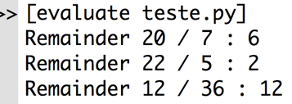
Functions: arguments position

Slide 51
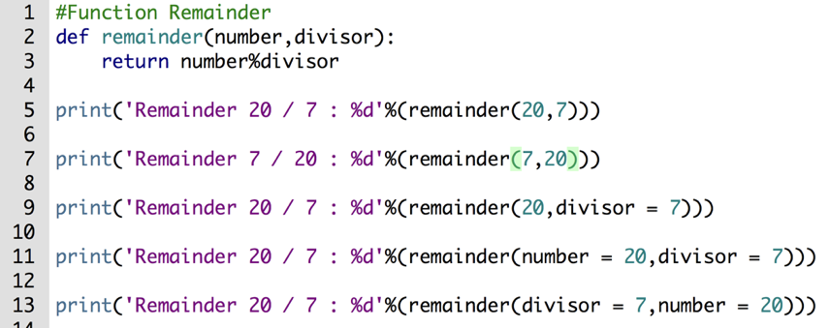
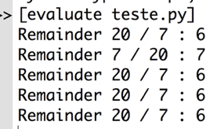
Functions: arguments keyword

Slide 52
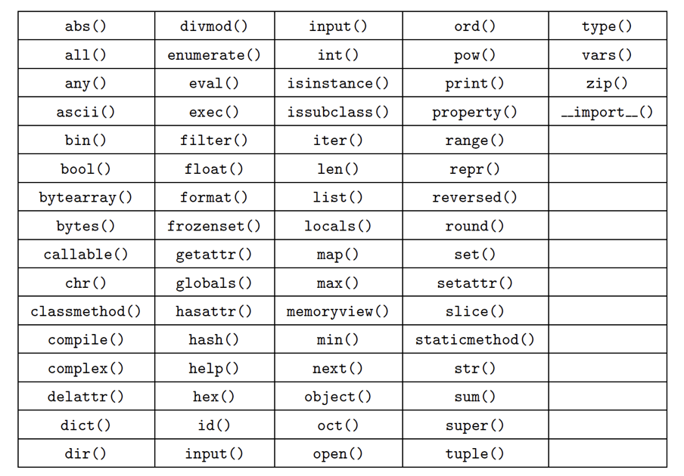
68 Built-in Functions

